Slide 1

Speak Fluently & Confidently B1- Course 1

Slide 2
Session 5- Talking about Travelling (ii)
Part 1-: At the Airport (Listening)
Part 2: What would you say in the following
situations? ( Idioms & collocations)
Part 3: Speaking Practice
https://befluent.me/

Slide 3
Session 5- Talking about Travelling (ii)
Part 1-: At the Airport
( Listening )
https://befluent.me/

Slide 4
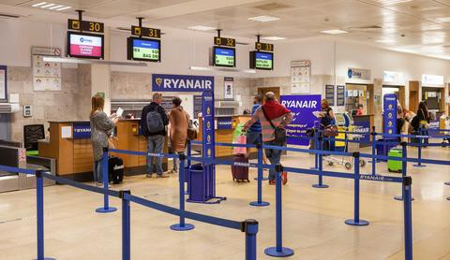
Lesson 5 II – Airport: Part 1
Are you ready to take a trip? We’re going to start a series of lessons on practical English for use while traveling. Today we’re going to go through the airport step by step, learning important vocabulary and useful phrases along the way.
Conversation #1 – At the Check-In Desk
Dan is flying from New York to Los Angeles. When he arrives at the airport, he goes to the check-in desk. Listen to the conversation he has with the agent:
Agent: Good afternoon! Where are you flying to today?
Dan: Los Angeles.
Agent: May I have your passport, please?
Dan: Here you go.
Agent: Are you checking any bags?
Dan: Just this one.
Agent: OK, please place your bag on the scale.
Dan: I have a stopover in Chicago – do I need to pick up my luggage there?
Agent: No, it’ll go straight through to Los Angeles. Here are your boarding passes – your flight leaves from gate 15A and it’ll begin boarding at 3:20. Your seat number is 26E.
Dan: Thanks.

Slide 5
Conversation Vocabulary and Phrases
Instead of “Where are you flying today?” the agent may ask “What’s your final destination?” The answer will be the same!
You can say “Here you go” anytime you give something to somebody
To check your bags means to put them on the airplane inside the cargo compartment. The small bag you take with you on the airplane is called
a carry-on. You need to put your carry-on bags through the X-ray machine at security.
The scale is the equipment that tells you the weight of your luggage (45 kilograms, for example)
A stopover or layover is when the airplane stops in a different city before continuing to the final destination
If the agent says that your luggage will go straight through, it means it will go directly to the final destination (and you don’t need to pick it up during your stopover)
Boarding passes are the tickets that permit you to enter the airplane
When a plane begins boarding, it means that the passengers start to enter the plane. Usually boarding time is 30-60 minutes before takeoff (when the plane leaves)
Other Questions & Phrases for the Airport
“Excuse me, where is the American Airlines check-in desk?”
“How many bags can I check?”
“Will my luggage go straight through, or do I need to pick it up in [Chicago]?”
“How much is the fee?”
If your bag is heavier than the weight limits, or if your bag is larger than the size limits, you may need to pay extra: an oversized baggage fee or overweight baggage fee (this can be $75 to $300). Some airlines in the United
States also charge a fee for ALL checked bags (usually $15 to $30).
“Please mark this bag as ‘fragile.’”
Say this if you have fragile or sensitive items in your bag that might break
“Is the flight on time?”
The agent will respond either “Yes” if the flight is on time, or “There’s a 20- minute delay” (for example) if the flight will leave later than expected.

Slide 6
Extra questions in the U.S.
On flights going to or inside the U.S., you might be asked some extra security questions before or during check-in. Here are some sample questions:
Answer YES to these questions:
Did you pack your bags yourself?
Has your luggage been in your possession at all times?
Are you aware of the regulations regarding liquids in your carry-on? (Liquids must be 100 mL or less, and stored in a single quart-sized clear plastic bag. More information: TSA.gov)
Answer NO to these questions:
Are you carrying any firearms or flammable materials?
Have you left your luggage unattended at any time?
Has anyone given you anything to carry on the flight?
Conversation #2 – Going through Security
There are two pieces of equipment in security: you put your bags through the X-ray machine, and you walk through the metal detector. Some airports also use a body scanner for a more careful check.
The X-ray machine has a conveyor belt that moves your bags automatically through the machine. You can put small items like keys or money into plastic bins.
In the picture below, the woman is walking through the metal detector.
Her suitcase is on the conveyor belt after going through the X-ray machine.

Slide 7
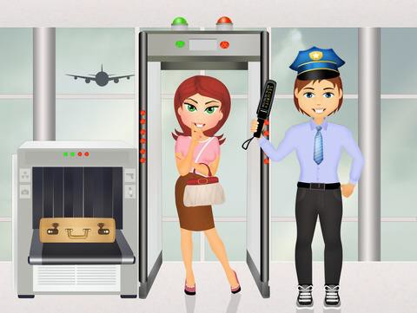
Agent: Please lay your bags flat on the conveyor belt, and use the bins for small objects.
Dan: Do I need to take my laptop out of the bag?
Agent: Yes, you do. Take off your hat and your shoes, too.
(he walks through the metal detector)
[BEEP BEEP BEEP BEEP]
Agent: Please step back. Do you have anything in your pockets – keys, cell phone, loose change?
Dan: I don’t think so. Let me try taking off my belt. Agent: Okay, come on through.

Slide 8
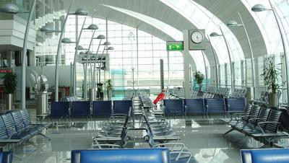
(he goes through the metal detector again)
Agent: You’re all set! Have a nice flight.
The phrase “you’re all set” is a common expression that means “you’re finished and everything is OK.”
Phrasal Verbs: SET OFF and GO OFF
When the alarm sounds, we say “the alarm went off.” To describe what caused the
alarm to sound, we say “set off” – for example, “My keys set off the alarm” or “My keys set off the metal detector.”
Announcements at the Gate
Airports are divided into terminals (the major sections of the airport) and each terminal has many gates. The gate is the door you go through to enter the airplane. Here are a few announcements you might hear while you are at the gate, waiting for the plane to board.
“There has been a gate change.”
(this means the flight will leave from a different gate)
“United Airlines flight 880 to Miami is now boarding.”
(this means it’s time for passengers to enter the plane)
“Please have your boarding pass and identification ready for boarding.”
“We would like to invite our first- and business-class passengers to
board.”

Slide 9
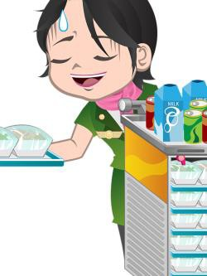
“We are now inviting passengers with small children and any
passengers requiring special assistance to begin boarding.”
“We would now like to invite all passengers to board.”
(this means everyone can enter the plane)
“This is the final boarding call for United Airlines flight 880 to Miami.” (this means it is the FINAL OPPORTUNITY to enter the plane before they close the doors)
“Passenger John Smith, please proceed to the United Airlines desk at gate 12.”
Conversation #3: On the plane
The people who work inside the airplane serving food and drinks are called flight attendants. Both men and women who have this job are called flight attendants. Listen to this conversation that Dan has with the flight attendant when dinner is served on the flight.
Flight attendant: Chicken or pasta?
Dan: Sorry?
Flight attendant: Would you like chicken or pasta?
Dan: I’ll have the chicken.
Flight attendant: Anything to drink?
Dan: What kind of soda do you have?
Flight attendant: Coke, Diet Coke, Sprite, Orange, and Dr. Pepper.
Dan: A Diet Coke, no ice, please.
Flight attendant: Here you go.

Slide 10

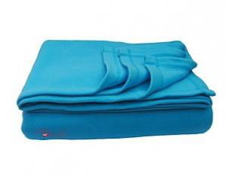


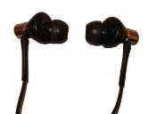

Dan: Thanks.
Conversation Tips:
If you didn’t understand what the flight attendant said, you can say
Sorry? or Pardon? to ask him or her to repeat it.
If you want to ask for something, you can use the phrase “Can I have…?” or “Could I have…?” Practice your pronunciation with these common requests:
“Can I have a pillow?”
“Can I have a blanket?”
“Can I have a pair of headphones/earbuds?”
“Could I have some water/coffee/tea?”
“Could I have some extra napkins?”
Finally, if you need to stand up, but there is a person sitting between you and the aisle, you can say Excuse me and make a motion to start standing up. The person sitting next to you will understand and stand up to let you get out of your seat.
You’ve finished Lesson 16! Now take the quiz to test how well you remember the phrases. In tomorrow’s lesson, you’ll learn English phrases for arriving at the destination airport, going through immigration, and dealing with common travel problems.

Slide 11
Quiz – Lesson 16
_ I have a coffee with milk, please?
Can
Will
Do
Excuse me, where is the Delta check-in ?
desk
station
table
I lost my pass - can I get another one?
traveling
seating
boarding
I have a in Paris on the way to Israel.
stayover
stopover
layoff
have the pasta, please.
I'll
I'm
I'd

Slide 12
You need to up your bag in Charlotte.
take
pick
get
A coffee, please.
regular
standard
normal
The metal in my belt the alarm.
set off
took off
went off
Do I _ to take off my shoes?
want
need
should
Is the flight on _ ?
hour
schedule
departure
There's a half-hour .
depart
delay
late

Slide 13
What of juices do you have?
can
kind
mark
How much is the oversized luggage ?
fee
tax
bill
What’s my _ number?
chair
seat
sit
Will my luggage go straight to New York?
away
through
out

Slide 14
Lesson 16 Quiz - Answers
1. A 2. A 3. C 4. B 5. A 6. B 7. A 8. A 9. B 10. B 11. B 12. B 13. A 14. B 15. B

Slide 15
Session 5- Talking about Travelling (ii)
Part 2: What would you say in the following
situations? ( Idioms & collocations)
https://befluent.me/

Slide 16
Session 5- Talking about Travelling
Collocations :
depart from, fly from, take off from
We will fly from Chicago's O'Hare airport
arrive at, land at, touch down at
The plane touched down at Glasgow airport just before midday
https://befluent.me/

Slide 17
Session 5- Talking about Travelling
Idioms:
1. To travel/ pack light
When someone says they need to pack or travel light, it means they can’t bring a lot of things with them on their trip.
For example: “I’m only going to the south for the weekend, so I have to pack light”.
2. To hit the road
To hit the road means to start a journey or to leave. It can also be used in normal, daily life when you decide it’s time for you to go home .
For example: “We have to be there by 10 am, so we’re hitting the road early tomorrow” or “I’ve been here long enough, it’s time I hit the road”.
3. To catch the sun
This idiom can be used whenever you go to the beach and someone gets sunburnt , so if you know anyone who gets burnt easily don’t miss the opportunity to use it with them!
For example: “Be careful you don’t catch too much sun at the beach, remember to put on some sunscreen!”
4. To live it up
Whenever you are having a really good time and enjoying your holiday , without worrying about anything (not even about money) you can use this idiom.
For example: “We’re really going to live it up in Las Vegas next month!”
5. On a shoestring/ on the cheap
This idiom is the complete opposite of the previous one. To do something on a shoestring or on the cheap, it means that you are doing it without spending a lot of money . .
For example: “I’m going to travel around Europe on a shoestring. I’ll be staying at hostels and buying food in supermarkets”
https://befluent.me/

Slide 18
Session 5- Talking about Travelling
Idioms:
6. At the crack of dawn
To do something at the crack of dawn means that you’re doing it just as the sun is rising . It means you’re doing it at the earliest possible time.
For example: “The plane leaves at 7.30 am, so we have to get up at the crack of dawn to get to the airport on time”.
7. To call it a day/ night
When someone calls it a day or a night, it means that they stop doing anything else for the rest of the day, or that they finish what they’re doing and go to bed .
For example: “We went sightseeing in Rome, but we ended up feeling so exhausted that we called it a day and went back to the hotel”.
8. Off the beaten track
If a place or something is off the beaten track, it means that it is far away from where many people live, or in a remote location .
For example: “I want to stay on this island all summer because it’s off the beaten track, so there’s not many people here and it’s quiet and peaceful.”
9. To catch the red-eye
When a person says they have to catch the red-eye it means they have to take a plane which is leaving very late at night .
For example: “I have to sleep during the day as I’m catching a red-eye tonight”.
10. Live out of a suitcase
To live out of a suitcase means that a person stays in many different places for only a short period of time, and with only enough things to put in a suitcase .
For example: “My cousin has been living out of a suitcase for years, her mother wishes she would settle down already”.
11. Break the journey
When someone breaks the journey, it means they decide to stop somewhere for a while during a long journey .
For example: “Our journey was so long that we decided to break the journey in a few places so we could rest for some days”.
https://befluent.me/

Slide 19
Session 5- Talking about Travelling (ii)
Part 3: Speaking Practice
https://befluent.me/

Slide 20
Session 5- Talking about Travelling (ii)
What do you like and dislike about airports? Why?
Do you think air transportation is the best way to travel? Why or why not?
What is your local airport like?
How do you think airports could be improved?
What is your most interesting airport experience?
How safe are airports?
What do your friends and colleagues say about airports?
Do you feel airports are easy to use?
If you were to travel through an airport in the near future, how would you prepare?
What are some things to do at the airport while waiting for your flight to board?
How do you feel about using English at the airport?
What would you like to learn about airports?
https://befluent.me/

Slide 21
Session 5- Talking about Travelling
Thank you!☺
https://befluent.me/

